Slide 1
Spring 2017 data analysis

Slide 2
Research Question
What are the joint effects of performance and solution transparency on the innovation outcome?

Slide 3
Hypotheses
Full transparency has the highest innovation performance compared to all 3 of the other treatment groups
Full transparency has the highest effort compared to all 3 of the other treatment groups
Full transparency has a higher total score of the apps being clicked across all phases compared to solution transparency
Full transparency has a higher number of clicks assigned to an app compared to solution transparency
Full transparency has a higher number of clicks done by a person compared to solution transparency

Slide 4
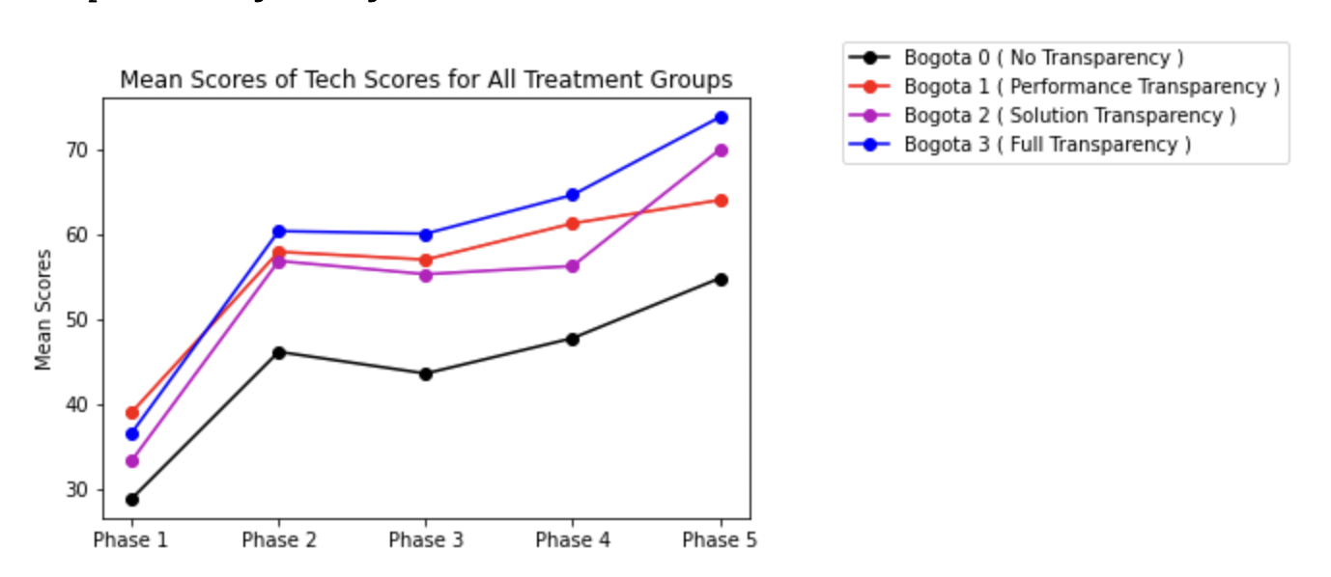
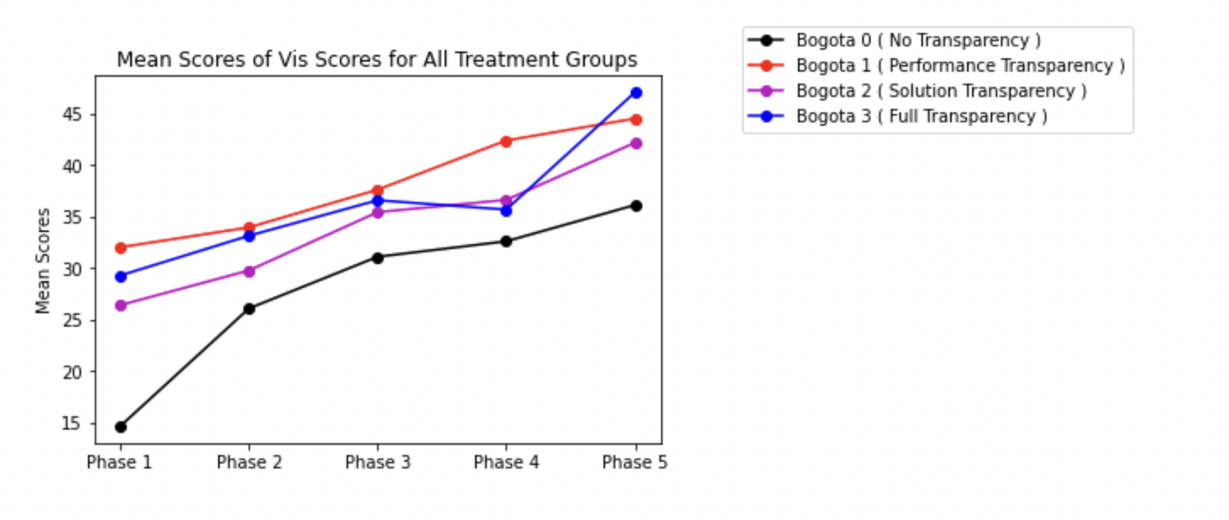
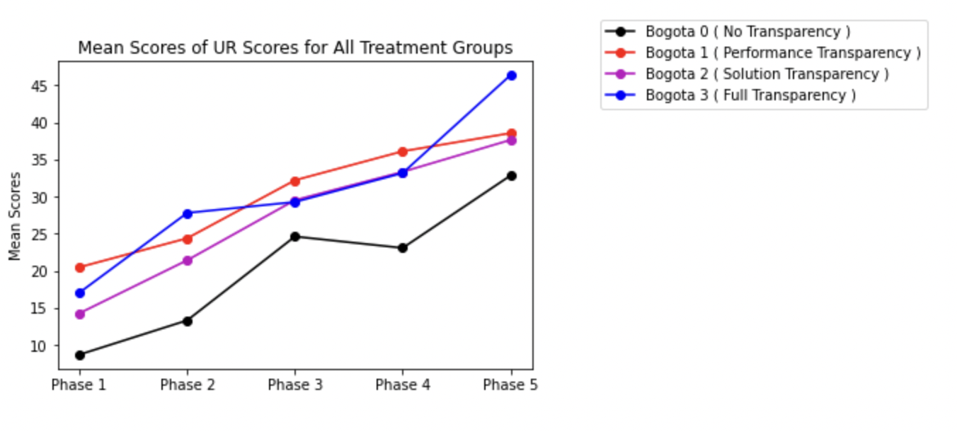
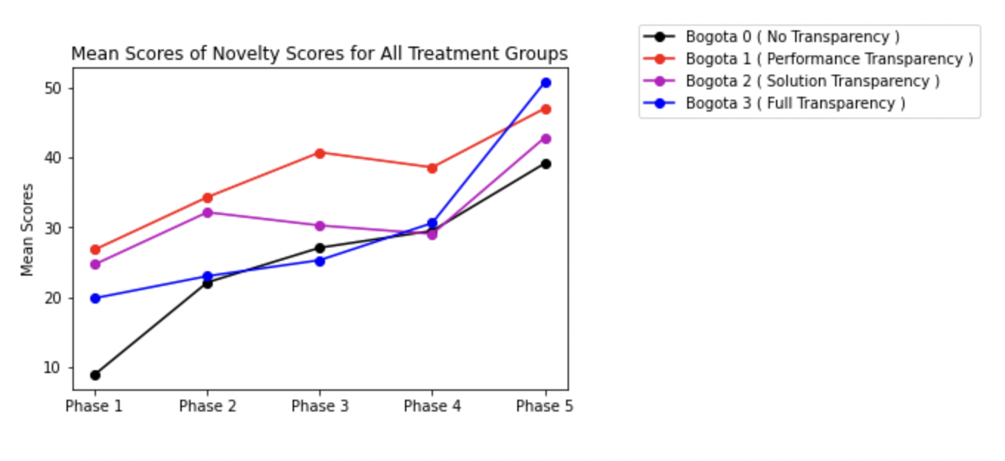
Line Plot of scores in 4 dimensions
Ref Link to Notebook - https://github.com/ironhacks/analysis-2017/blob/main/spring-2017/script/analysis/BoxPlots-LineCharts-BarCharts(Scores%2CLOC%2CD3%2CSurvey).ipynb

Slide 5
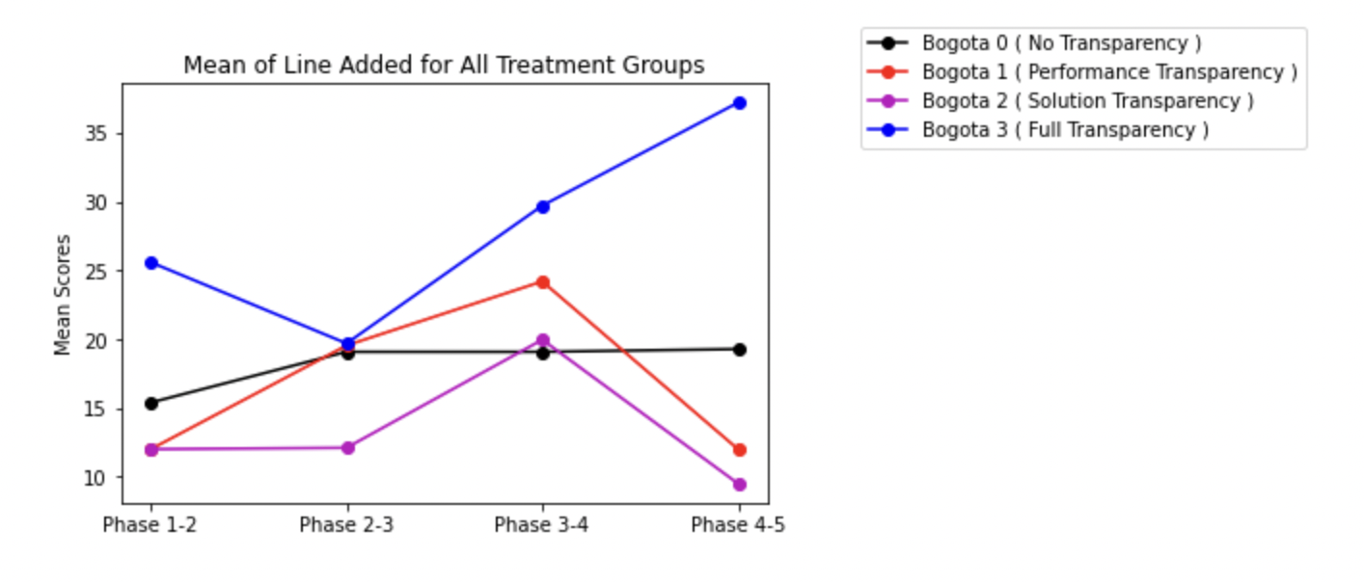
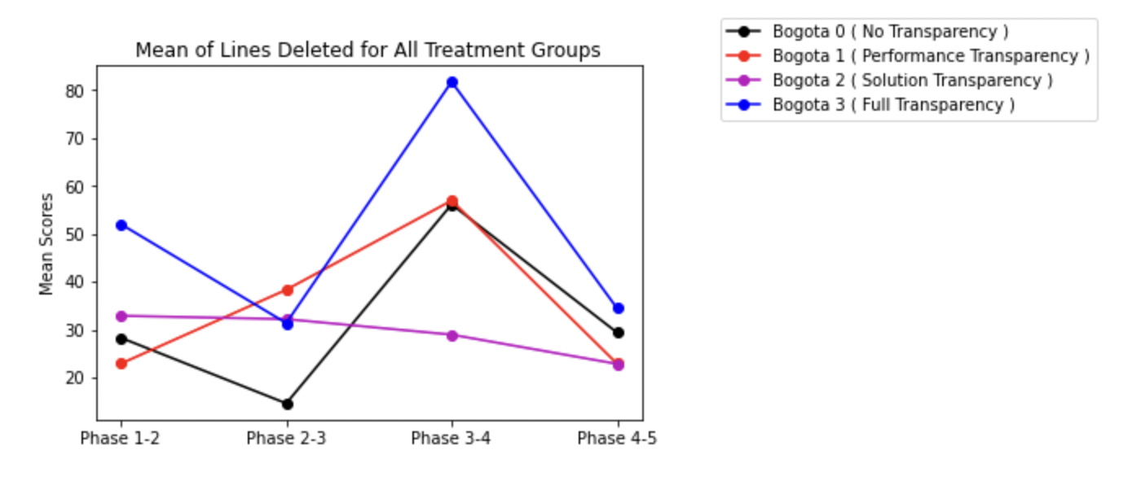
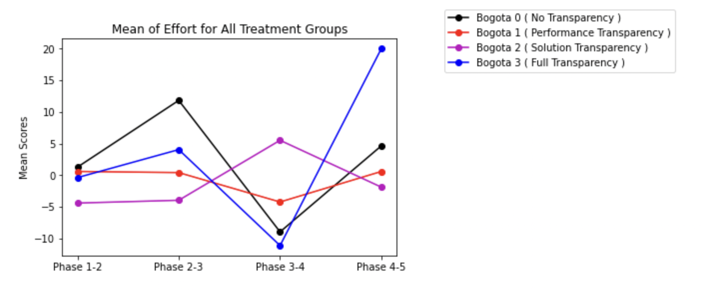
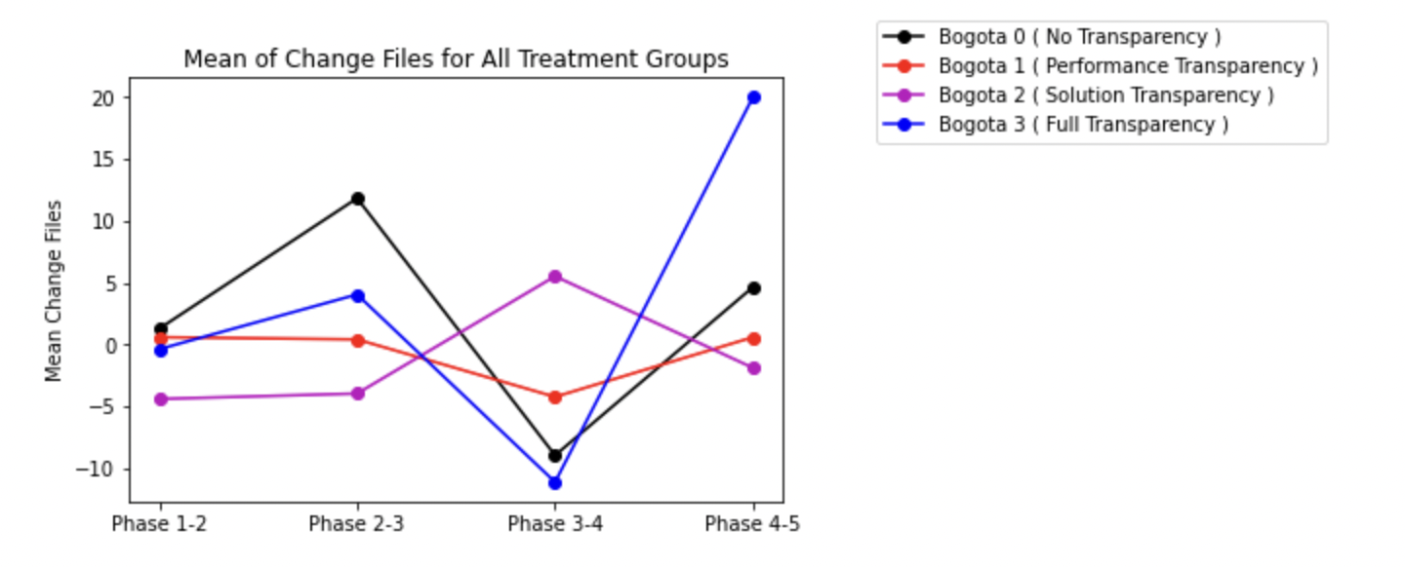
Lines added/deleted/effort/files change
Ref Link to Notebook - https://github.com/ironhacks/analysis-2017/blob/main/spring-2017/script/analysis/BoxPlots-LineCharts-BarCharts(Scores%2CLOC%2CD3%2CSurvey).ipynb

Slide 6
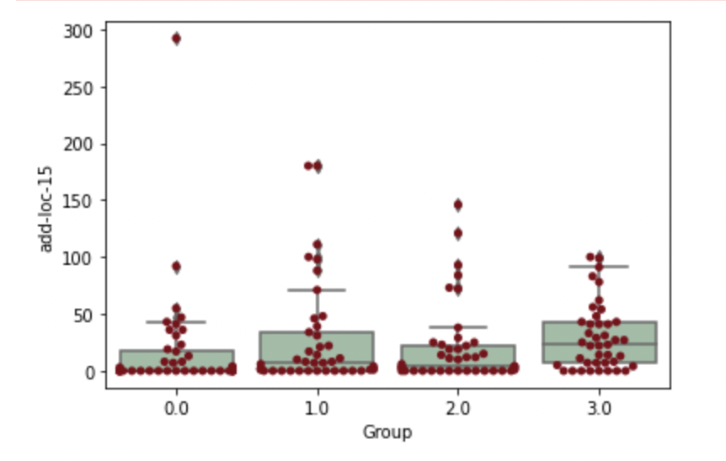
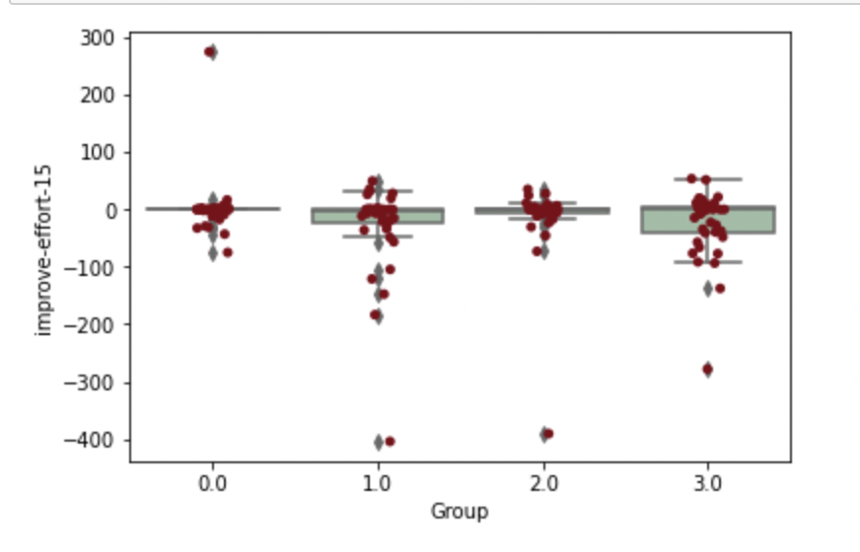
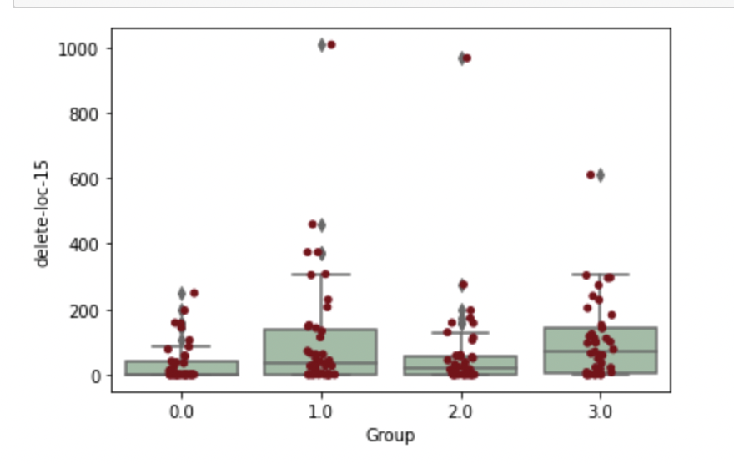
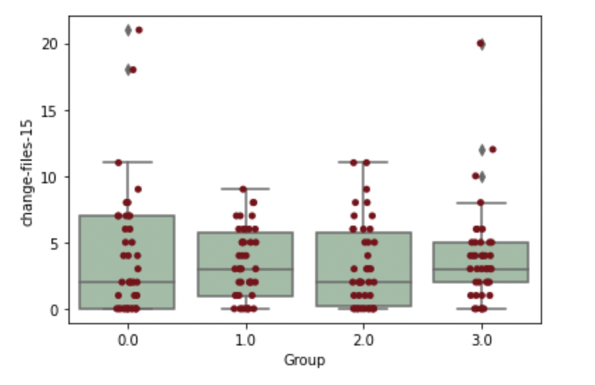
Median Lines added/deleted/effort/files change

Slide 7
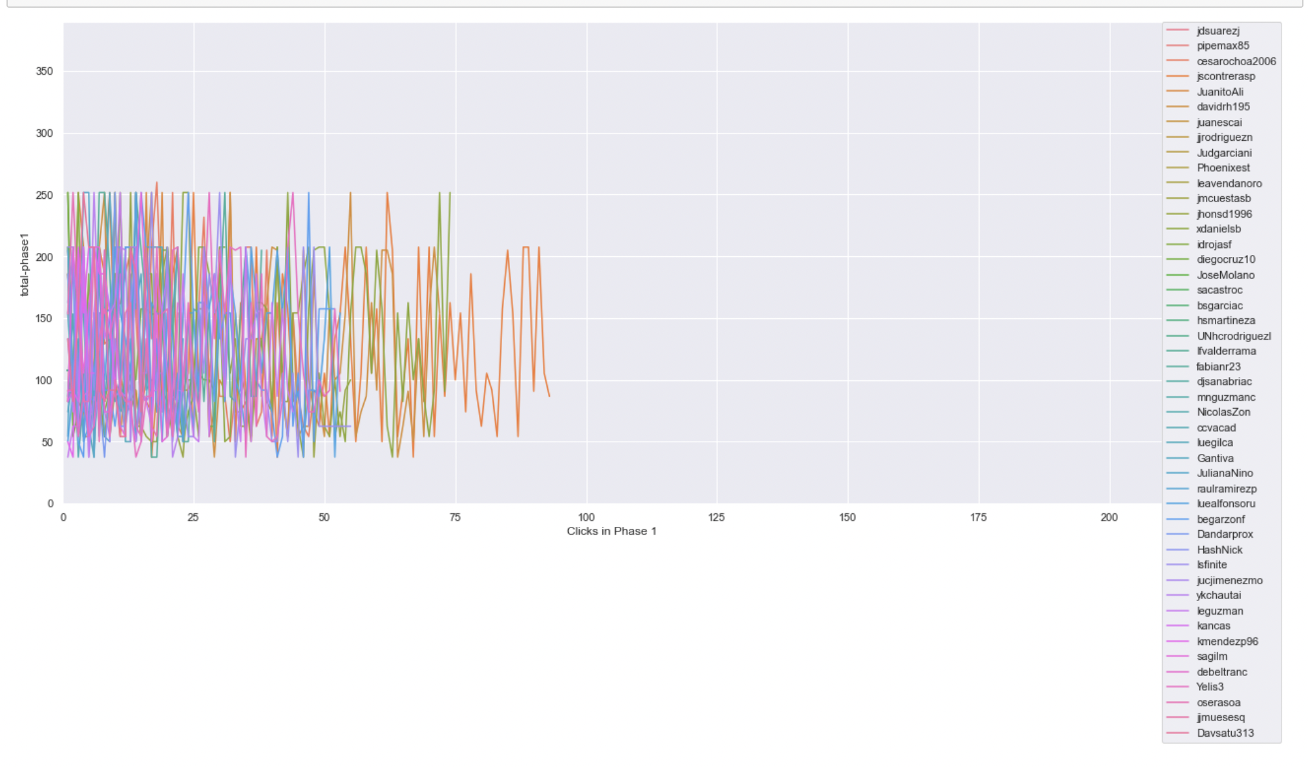
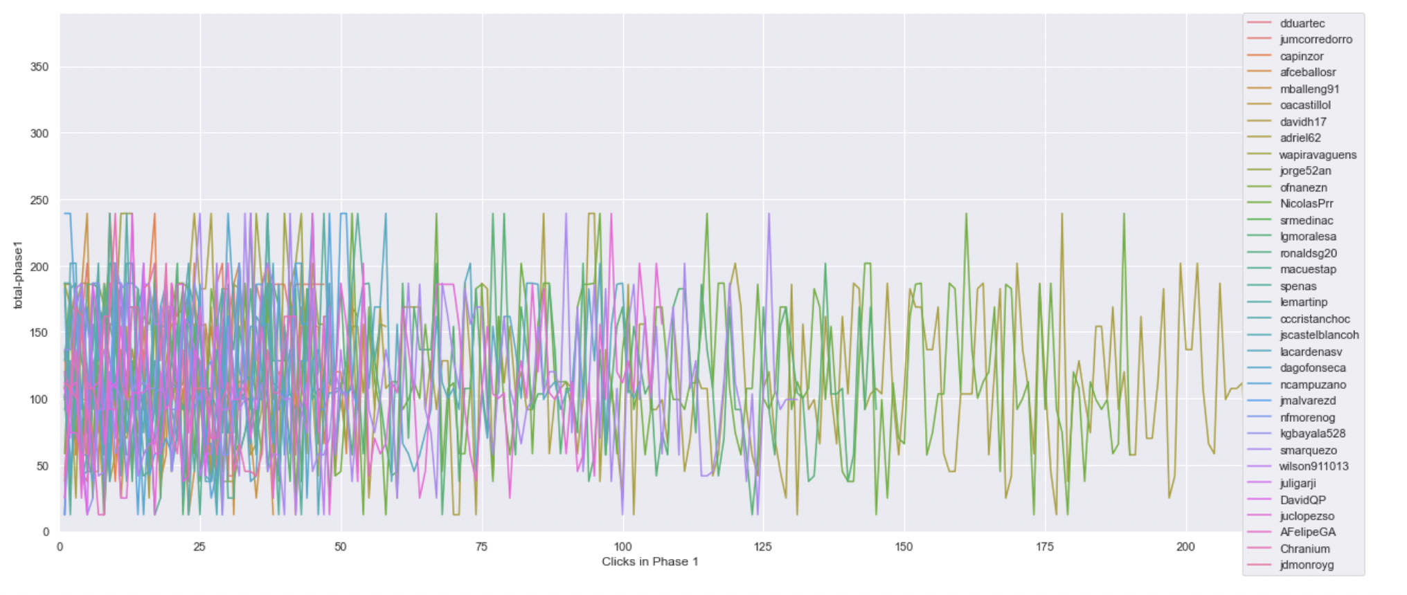
Timeline plot of scores of projects clicked on in phase 1 ( same scale )
Ref Link - https://github.com/ironhacks/analysis-2017/blob/main/spring-2017/script/analysis/Clicks-Analysis(Graphs%2CDescriptive-Analysis).ipynb
Bogota 2 ( Solution Transparency Only ) | Bogota 3 ( Full Transparency )

Slide 8
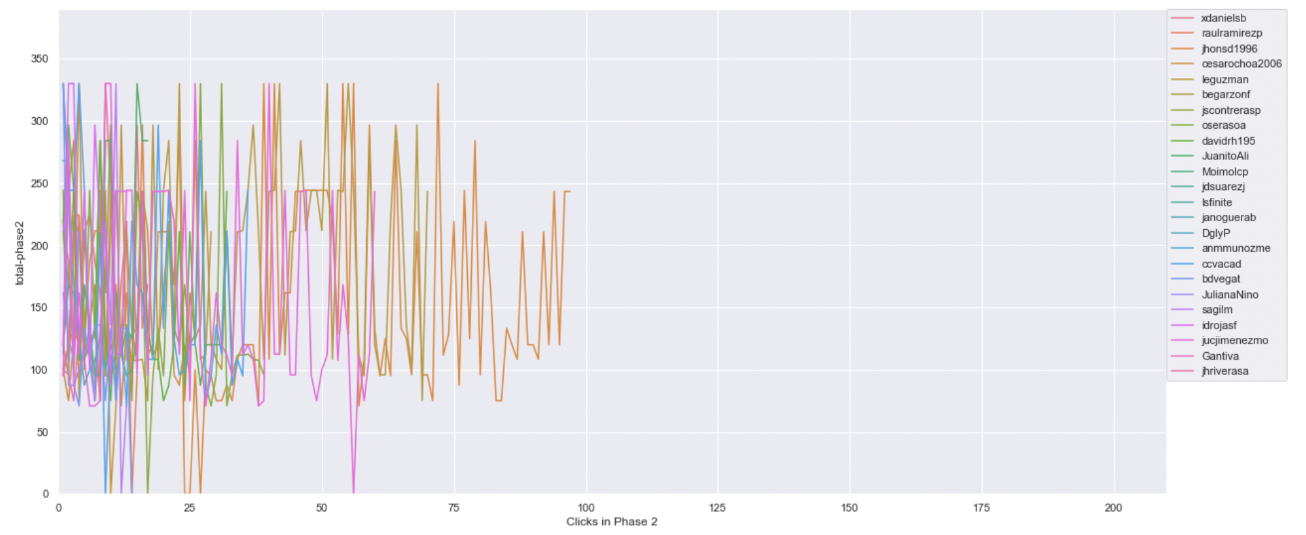
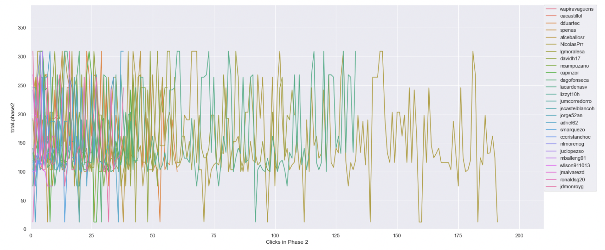
Timeline plot of scores of projects clicked on in phase 2 ( same scale )
Ref Link - https://github.com/ironhacks/analysis-2017/blob/main/spring-2017/script/analysis/Clicks-Analysis(Graphs%2CDescriptive-Analysis).ipynb
Bogota 2 ( Solution Transparency Only ) | Bogota 3 ( Full Transparency )

Slide 9
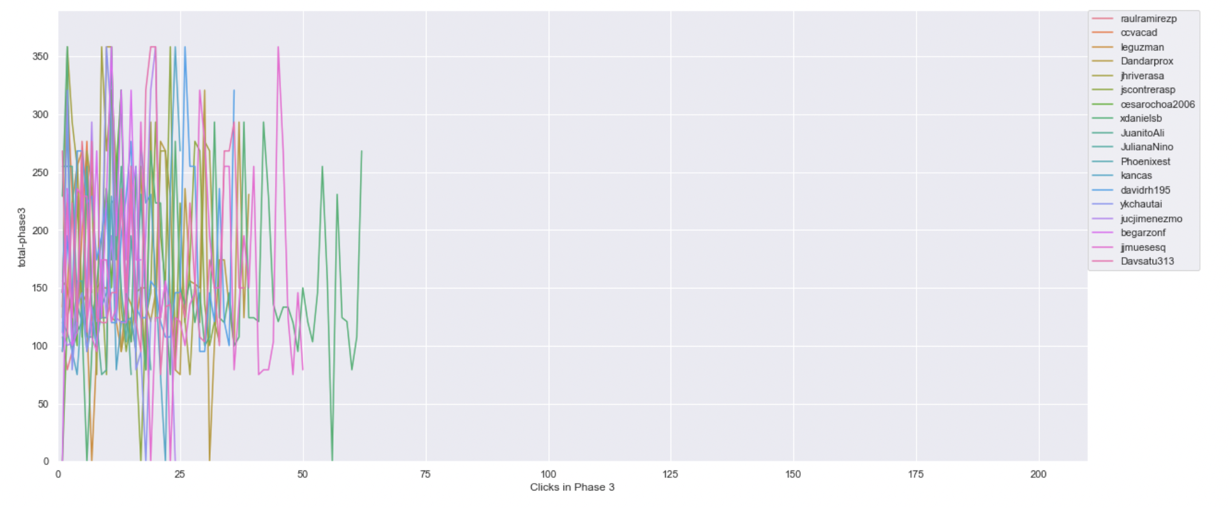
Timeline plot of scores of projects clicked on in phase 3 ( same scale )
Ref Link - https://github.com/ironhacks/analysis-2017/blob/main/spring-2017/script/analysis/Clicks-Analysis(Graphs%2CDescriptive-Analysis).ipynb
Bogota 2 ( Solution Transparency Only ) | Bogota 3 ( Full Transparency )

Slide 10
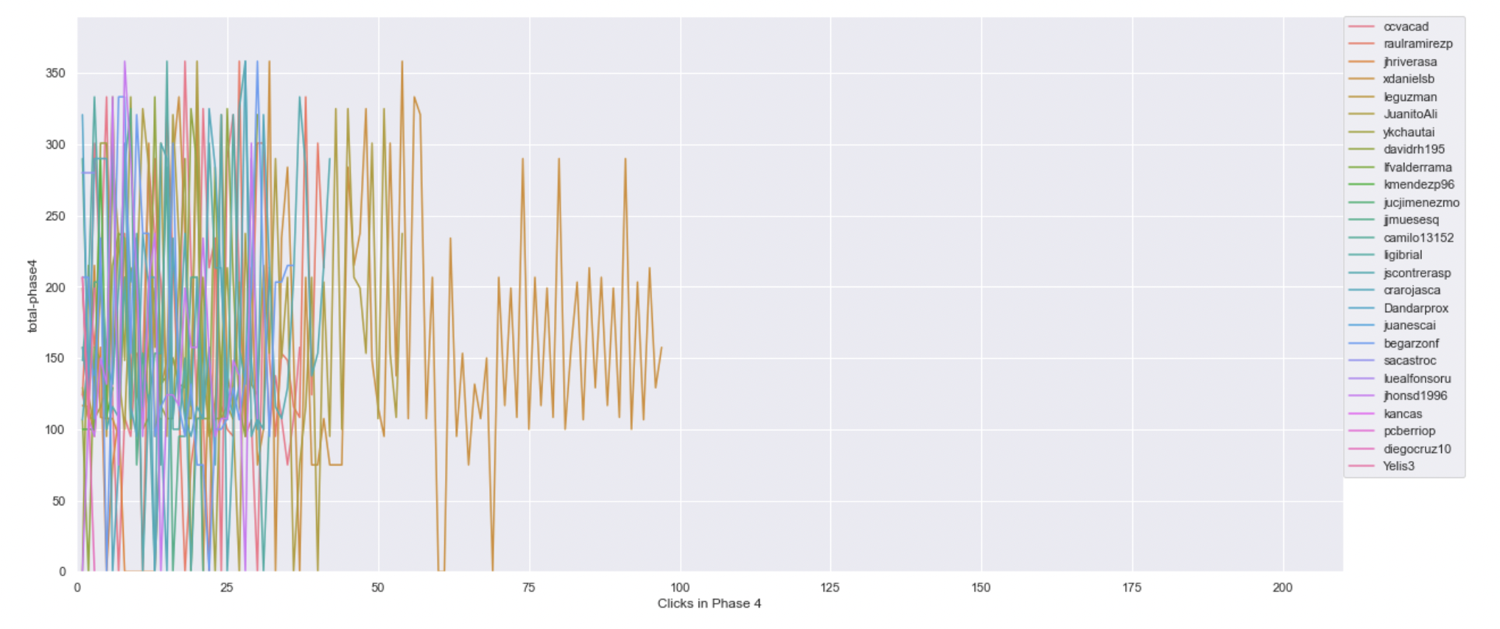
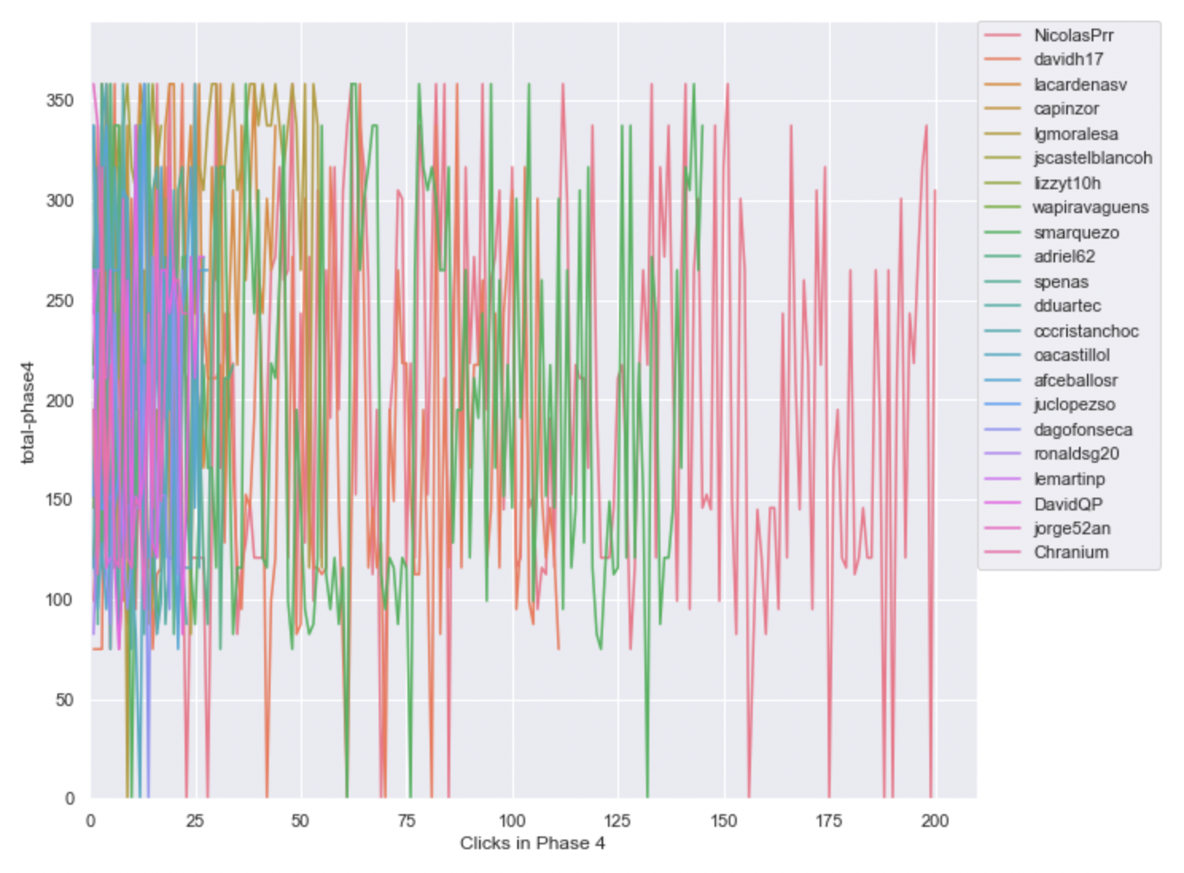
Timeline plot of scores of projects clicked on in phase 4 ( same scale )
Ref Link - https://github.com/ironhacks/analysis-2017/blob/main/spring-2017/script/analysis/Clicks-Analysis(Graphs%2CDescriptive-Analysis).ipynb
Bogota 2 ( Solution Transparency Only ) | Bogota 3 ( Full Transparency )

Slide 11
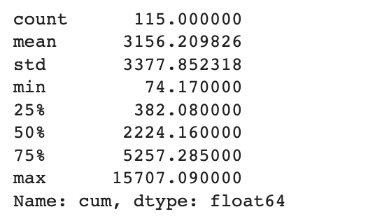
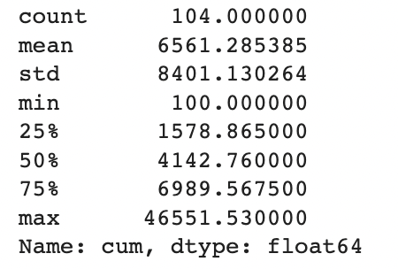
Total Score of the Apps Being Clicked Across All Phases ( Descriptive Analysis )
Ref Link - https://github.com/ironhacks/analysis-2017/blob/main/spring-2017/script/analysis/Clicks-Analysis(Graphs%2CDescriptive-Analysis).ipynb
Bogota 2 ( Solution Transparency ) | Bogota 3 ( Full Transparency )

Slide 12
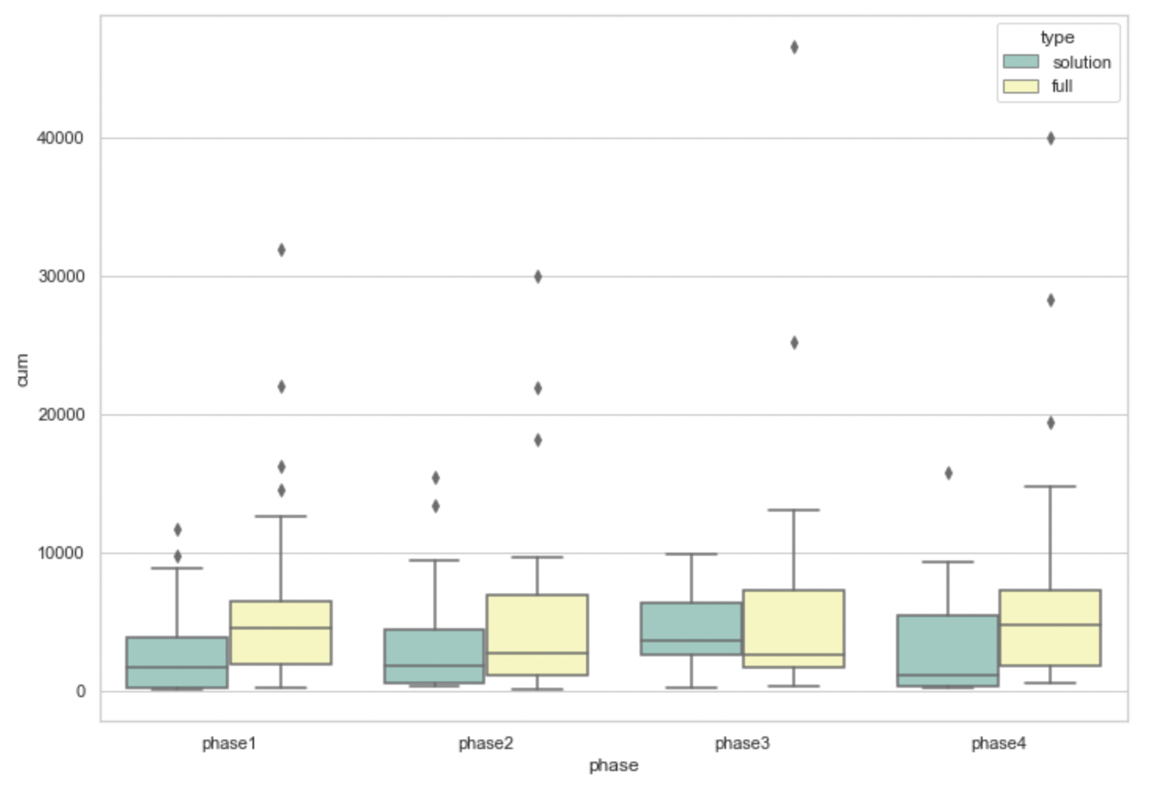
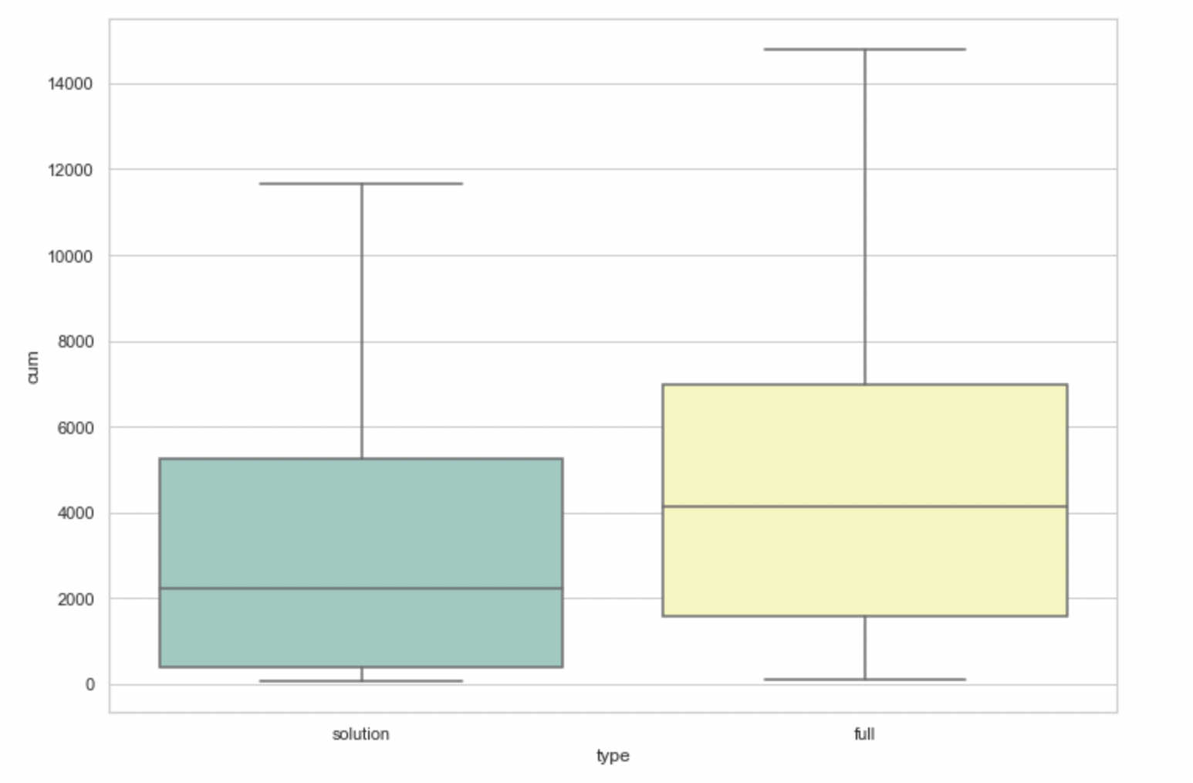
Total Score of the Apps Being Clicked Across All Phases ( box plots )
pvalue=0.00017575311061889564
( Independent T-test )

Slide 13
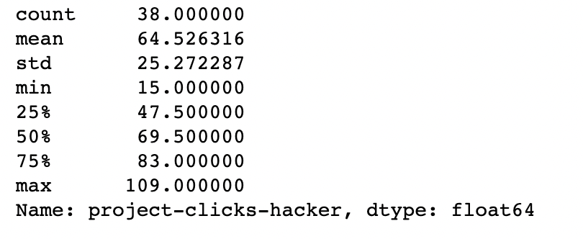
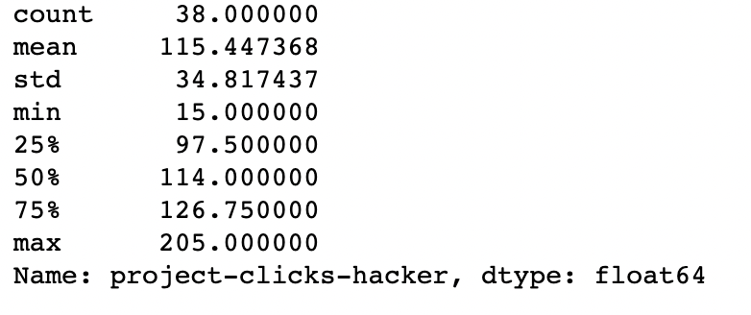
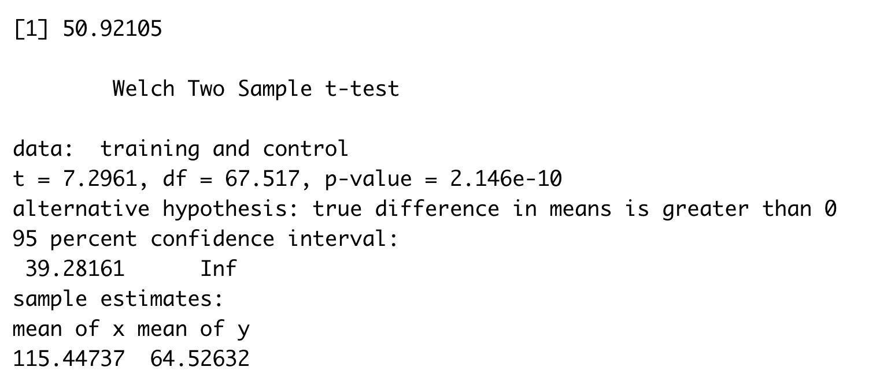
The number of clicks assigned to an app
Bogota 2 ( Solution Transparency ) | Bogota 3 ( Full Transparency )

Slide 14
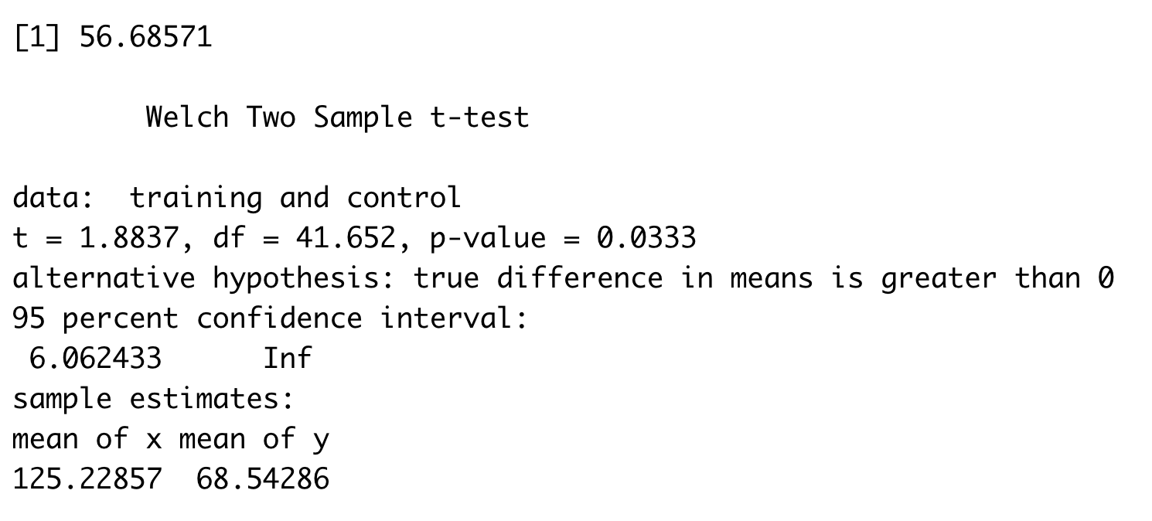
The number of clicks done by a person
Bogota 2 ( Solution Transparency ) | Bogota 3 ( Full Transparency )
Stats for Solution Transparency Min. : 1.00 1st Qu.: 32.00 Median : 55.00 Mean : 68.54 3rd Qu.: 88.00 Max. :250.00 NA's :7 | Stats for Full Transparency Min. : 1.0 1st Qu.: 43.0 Median : 60.0 Mean :125.2 3rd Qu.:128.5 Max. :821.0 NA's :6

Slide 15
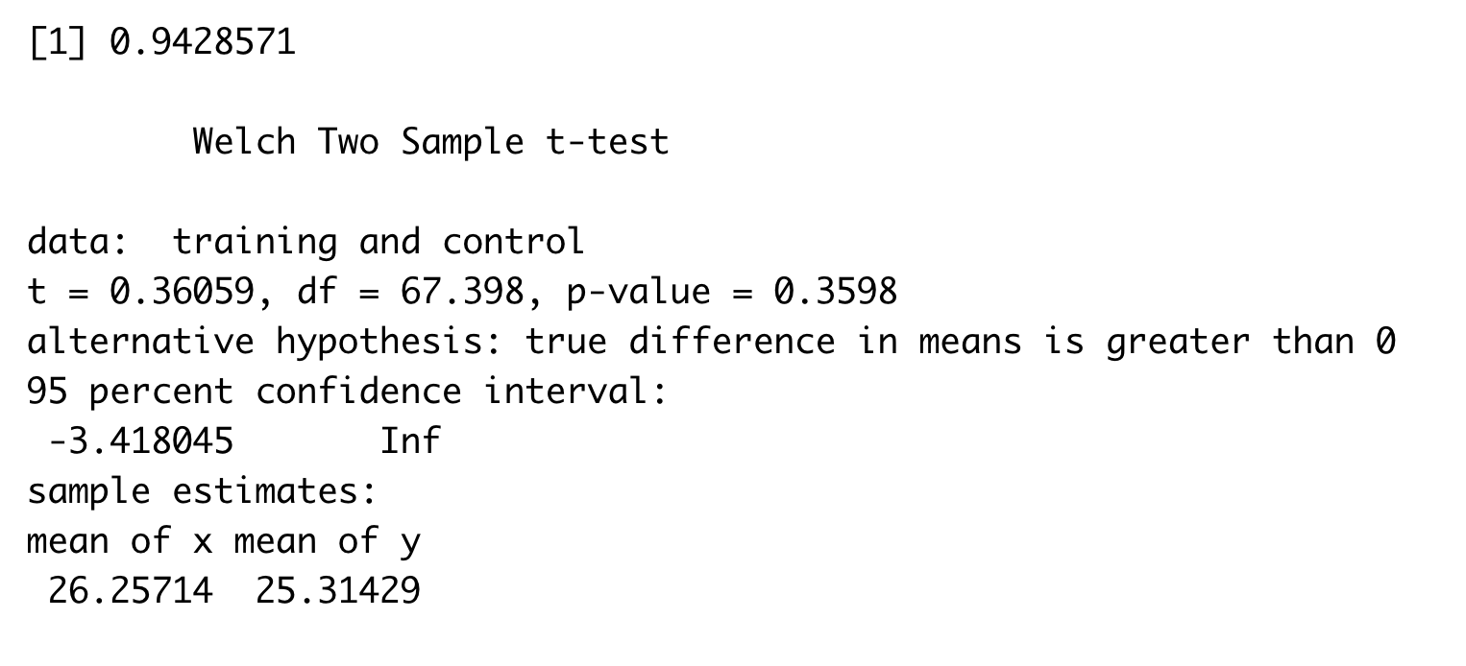
The number of unique apps explored
Bogota 2 ( Solution Transparency ) | Bogota 3 ( Full Transparency )
Stats for Solution Transparency count 35.000000 mean 25.314286 std 10.408626 min 1.000000 25% 20.500000 50% 27.000000 75% 34.500000 max 37.000000 | Stats for Full Transparency count 35.000000 mean 26.257143 std 11.443834 min 1.000000 25% 21.500000 50% 29.000000 75% 36.500000 max 38.000000

Slide 16
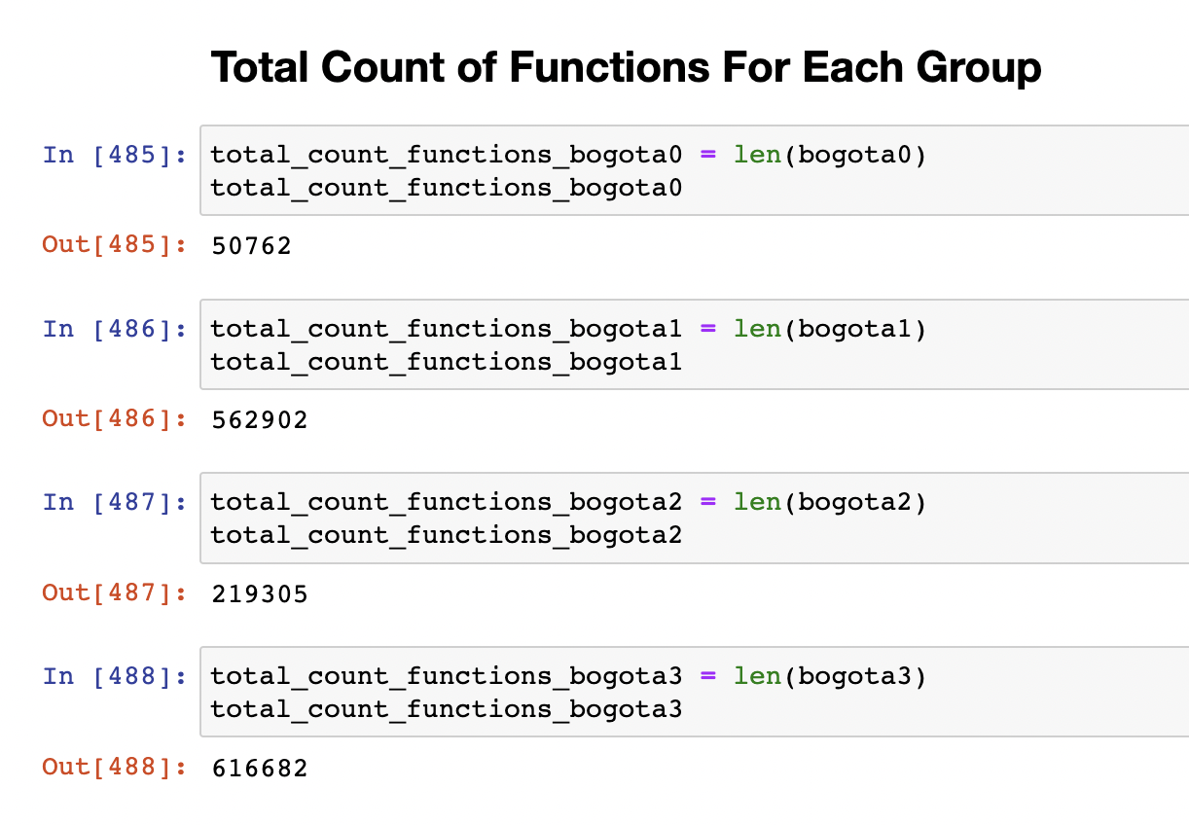
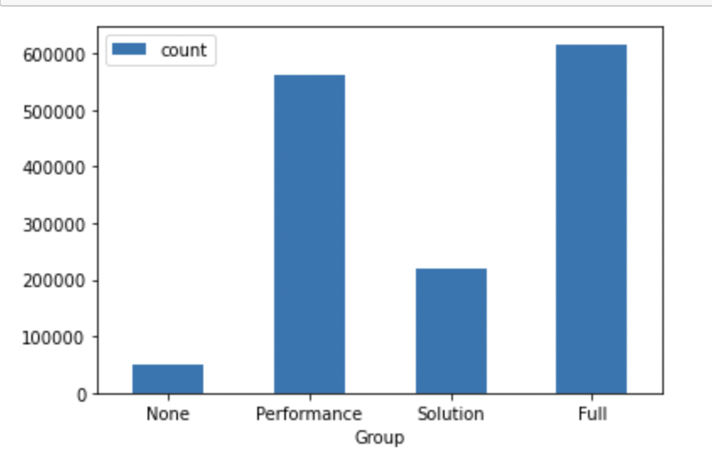
Total Count of Functions for Each Group

Slide 17
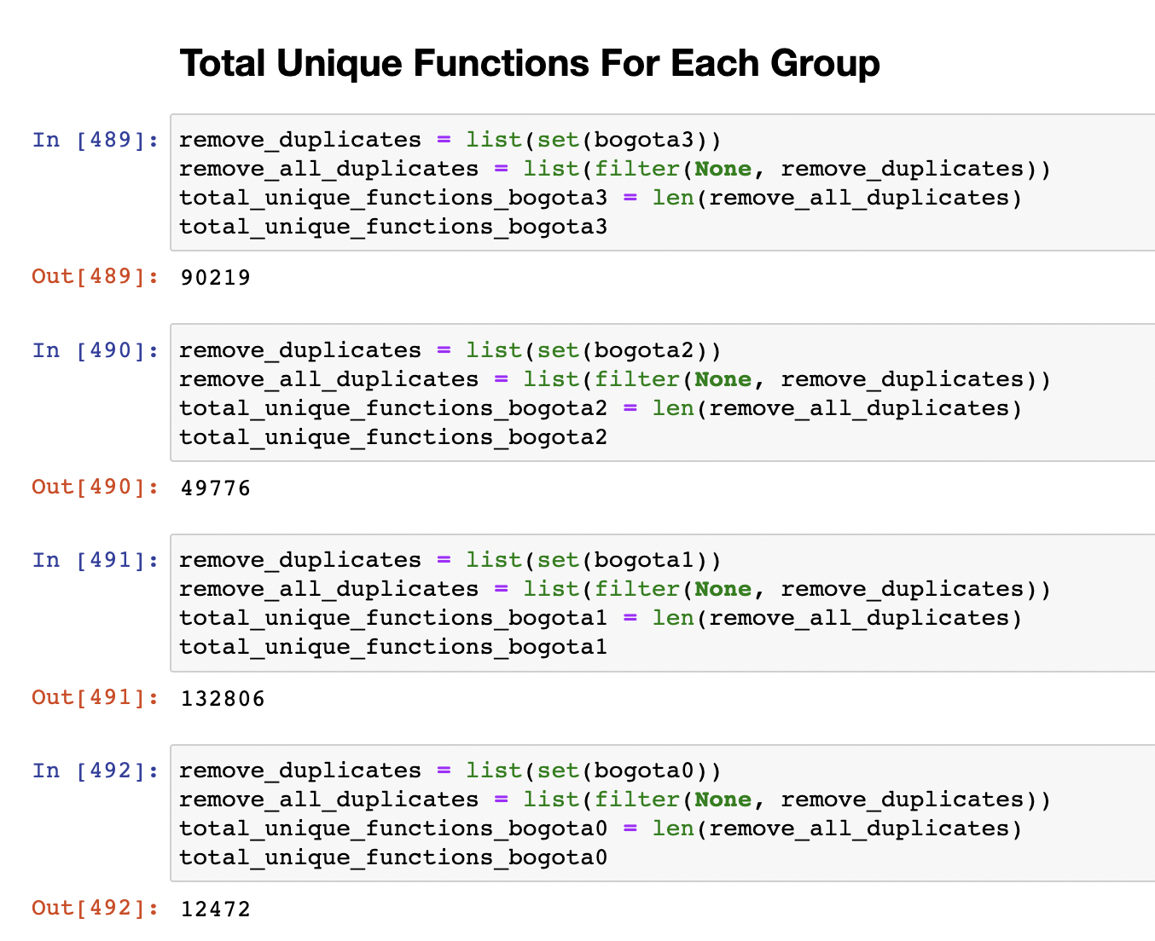
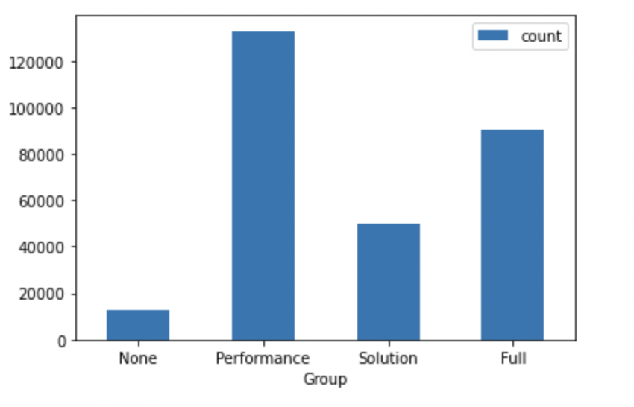
Total Unique Functions for Each Group

Slide 18
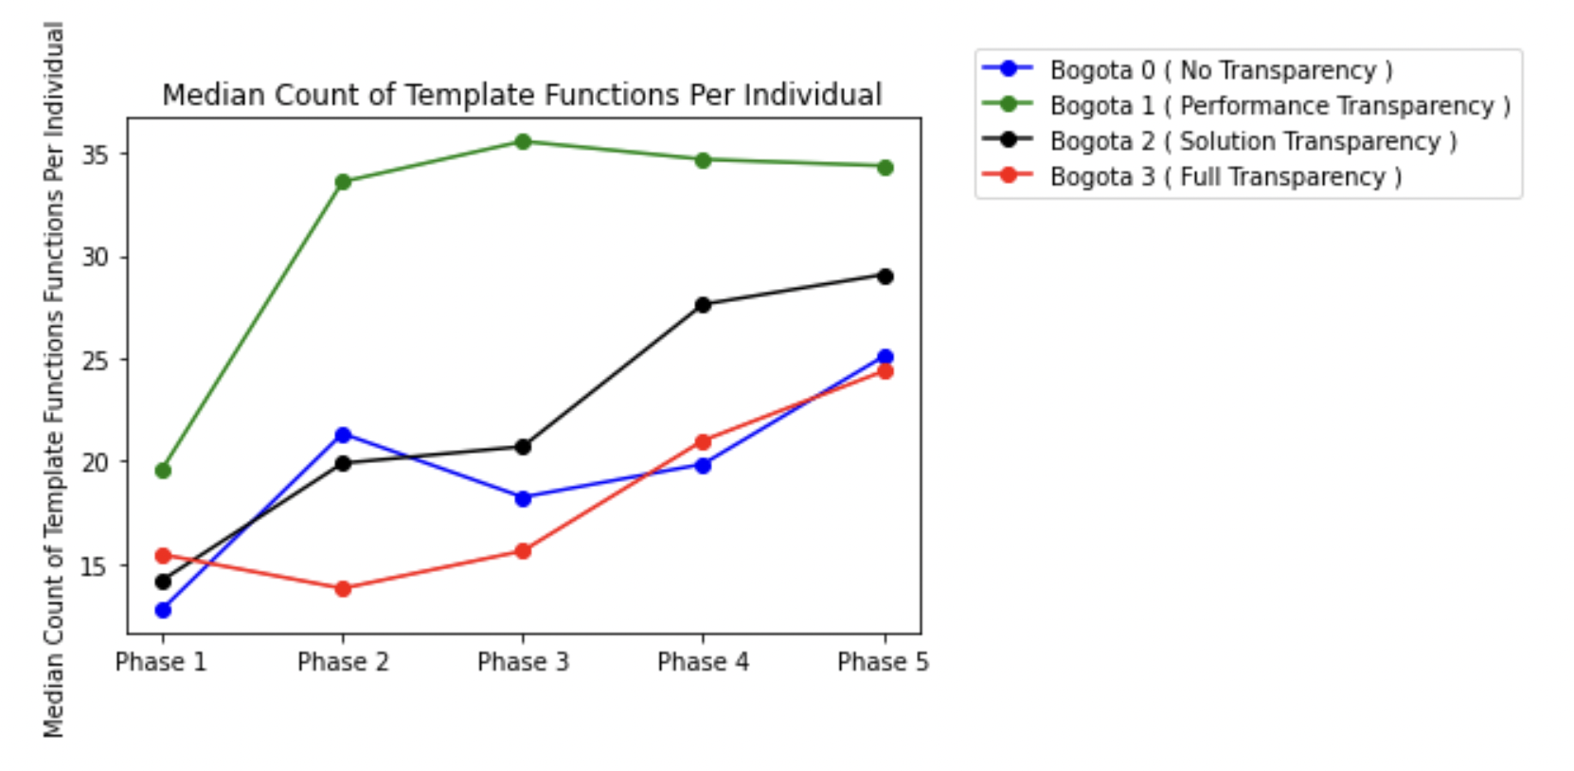
Median Count of Template Functions Per Individual

Slide 19
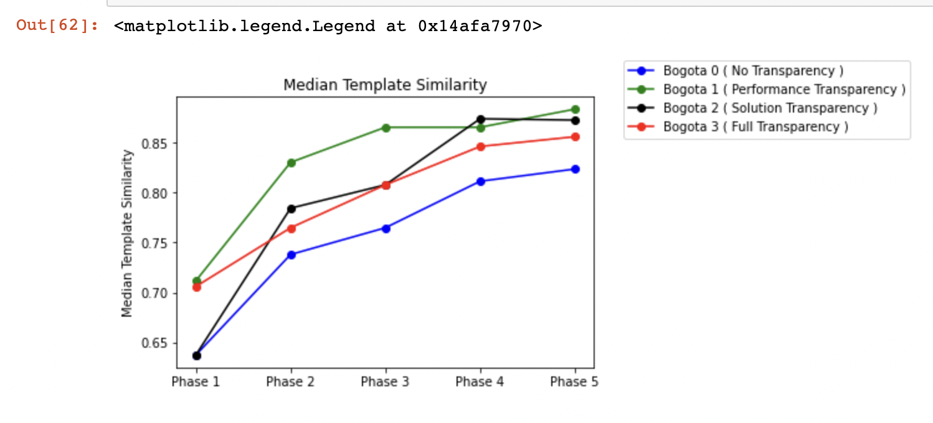
Median Template Similarity

Slide 20
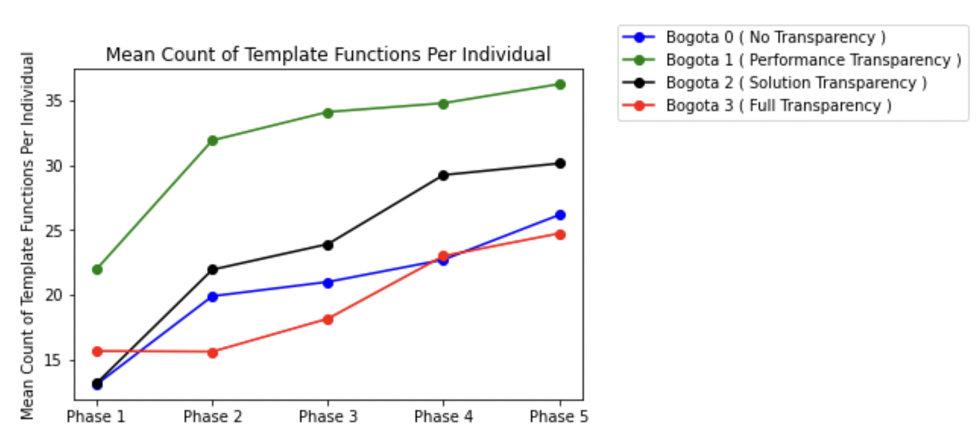
Mean Count of Template Functions Per Individual

Slide 21
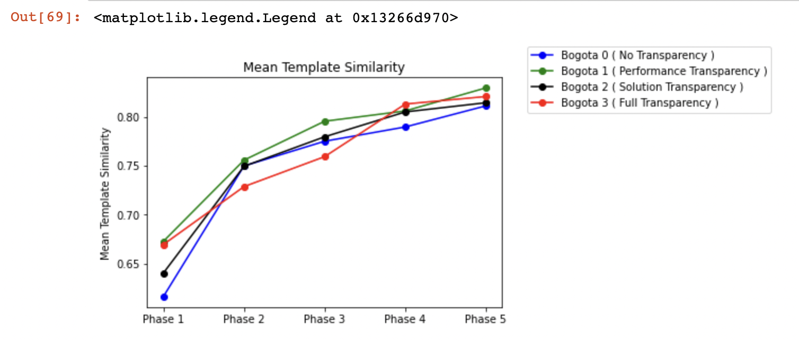
Mean Template Similarity

Slide 22
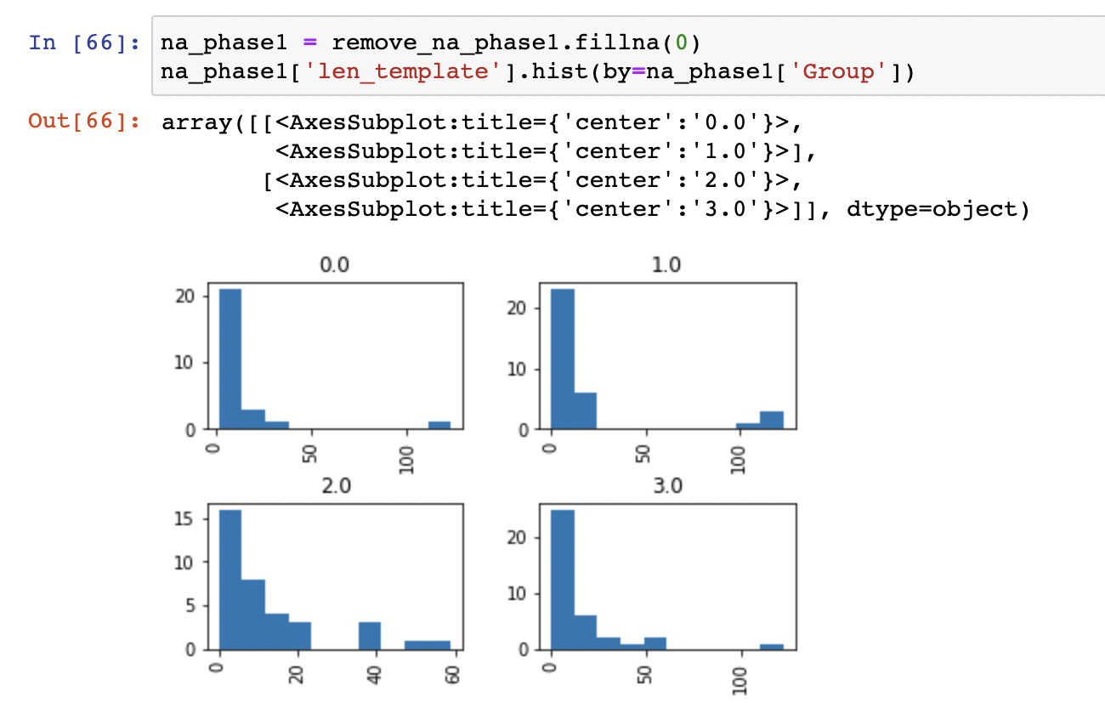
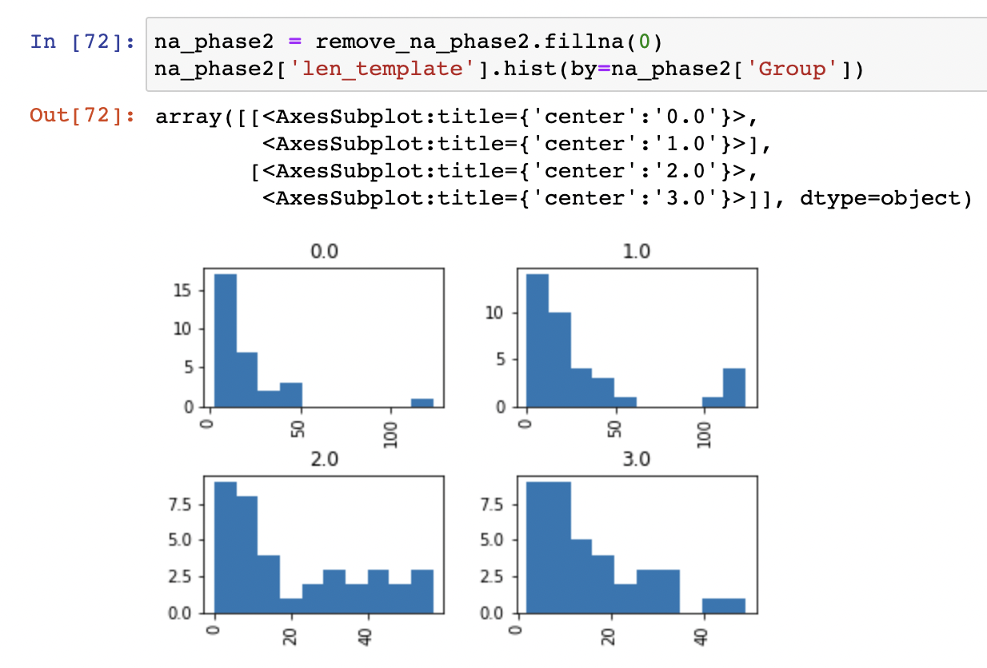
Distribution Plot of Template Functions Per Individual
Phase 1 | Phase 2

Slide 23
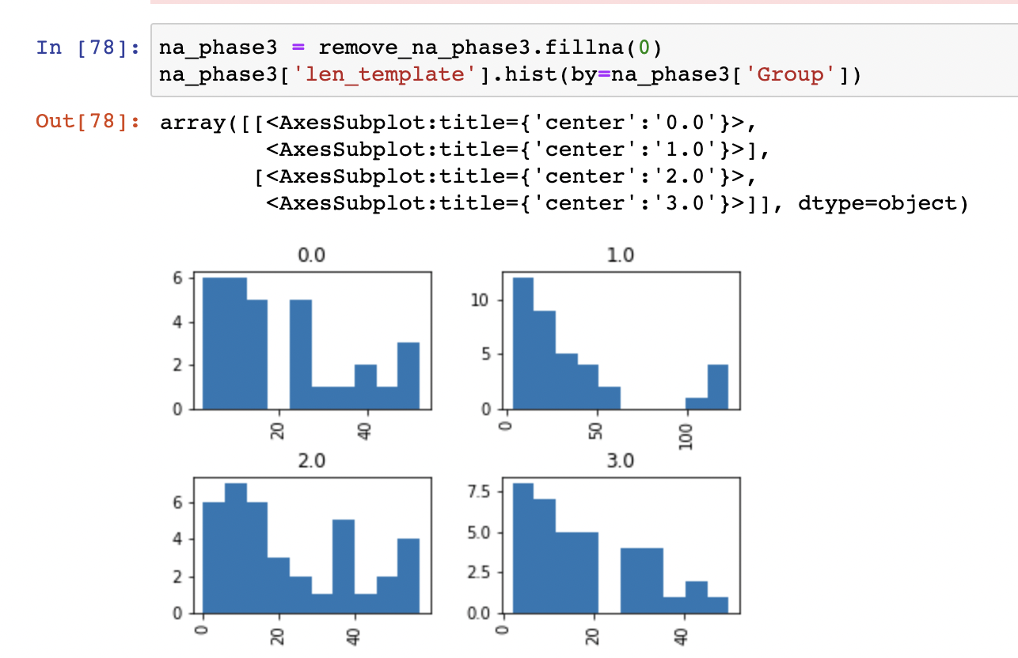
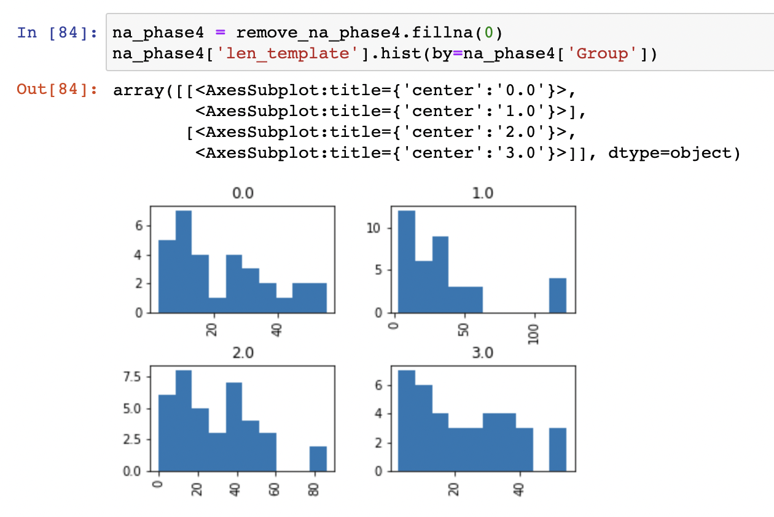
Distribution Plot of Template Functions Per Individual

Slide 24
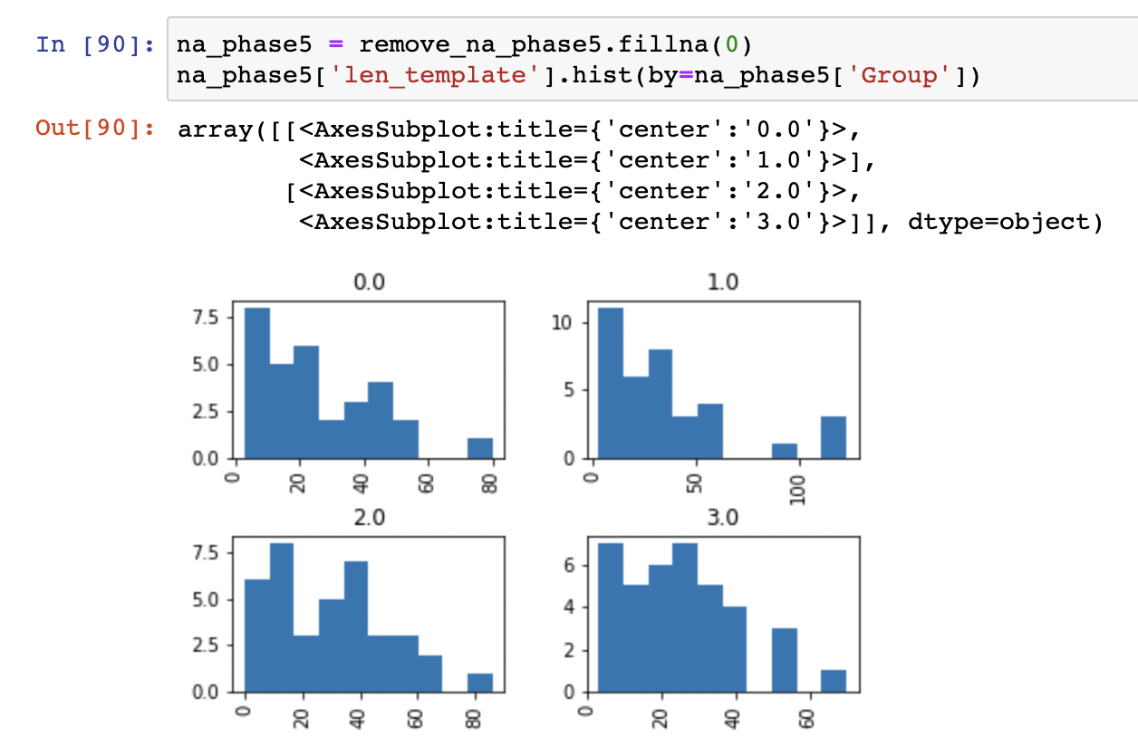
Distribution Plot of Template Functions Per Individual

Slide 25
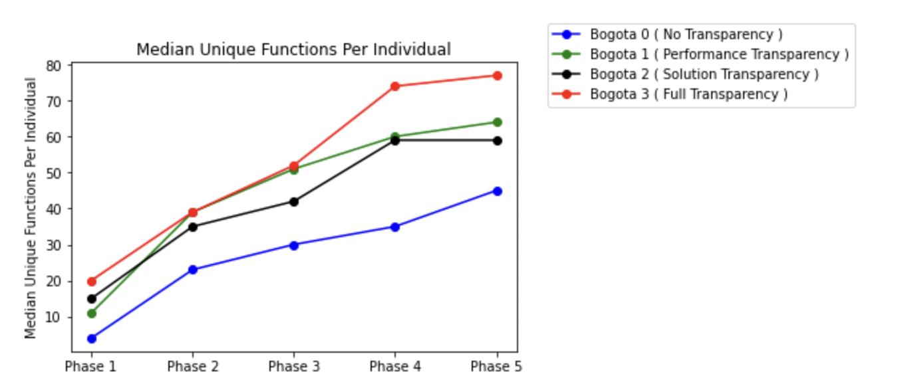
Median Unique Functions Per Individual [ Variety ] [ Repetition Removed ]

Slide 26
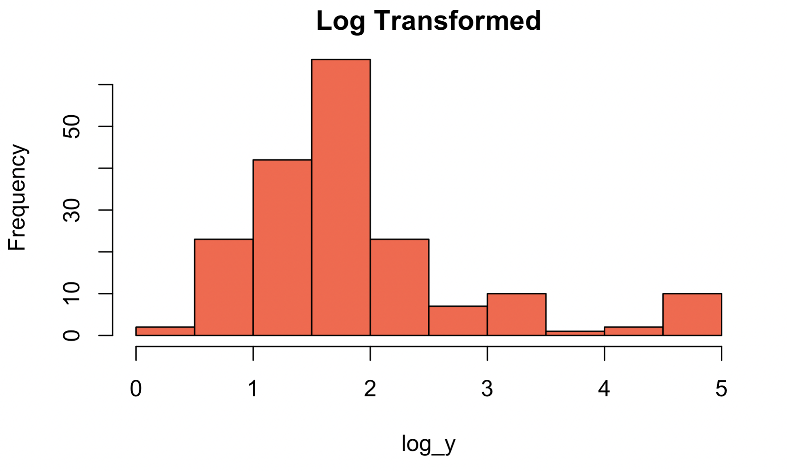
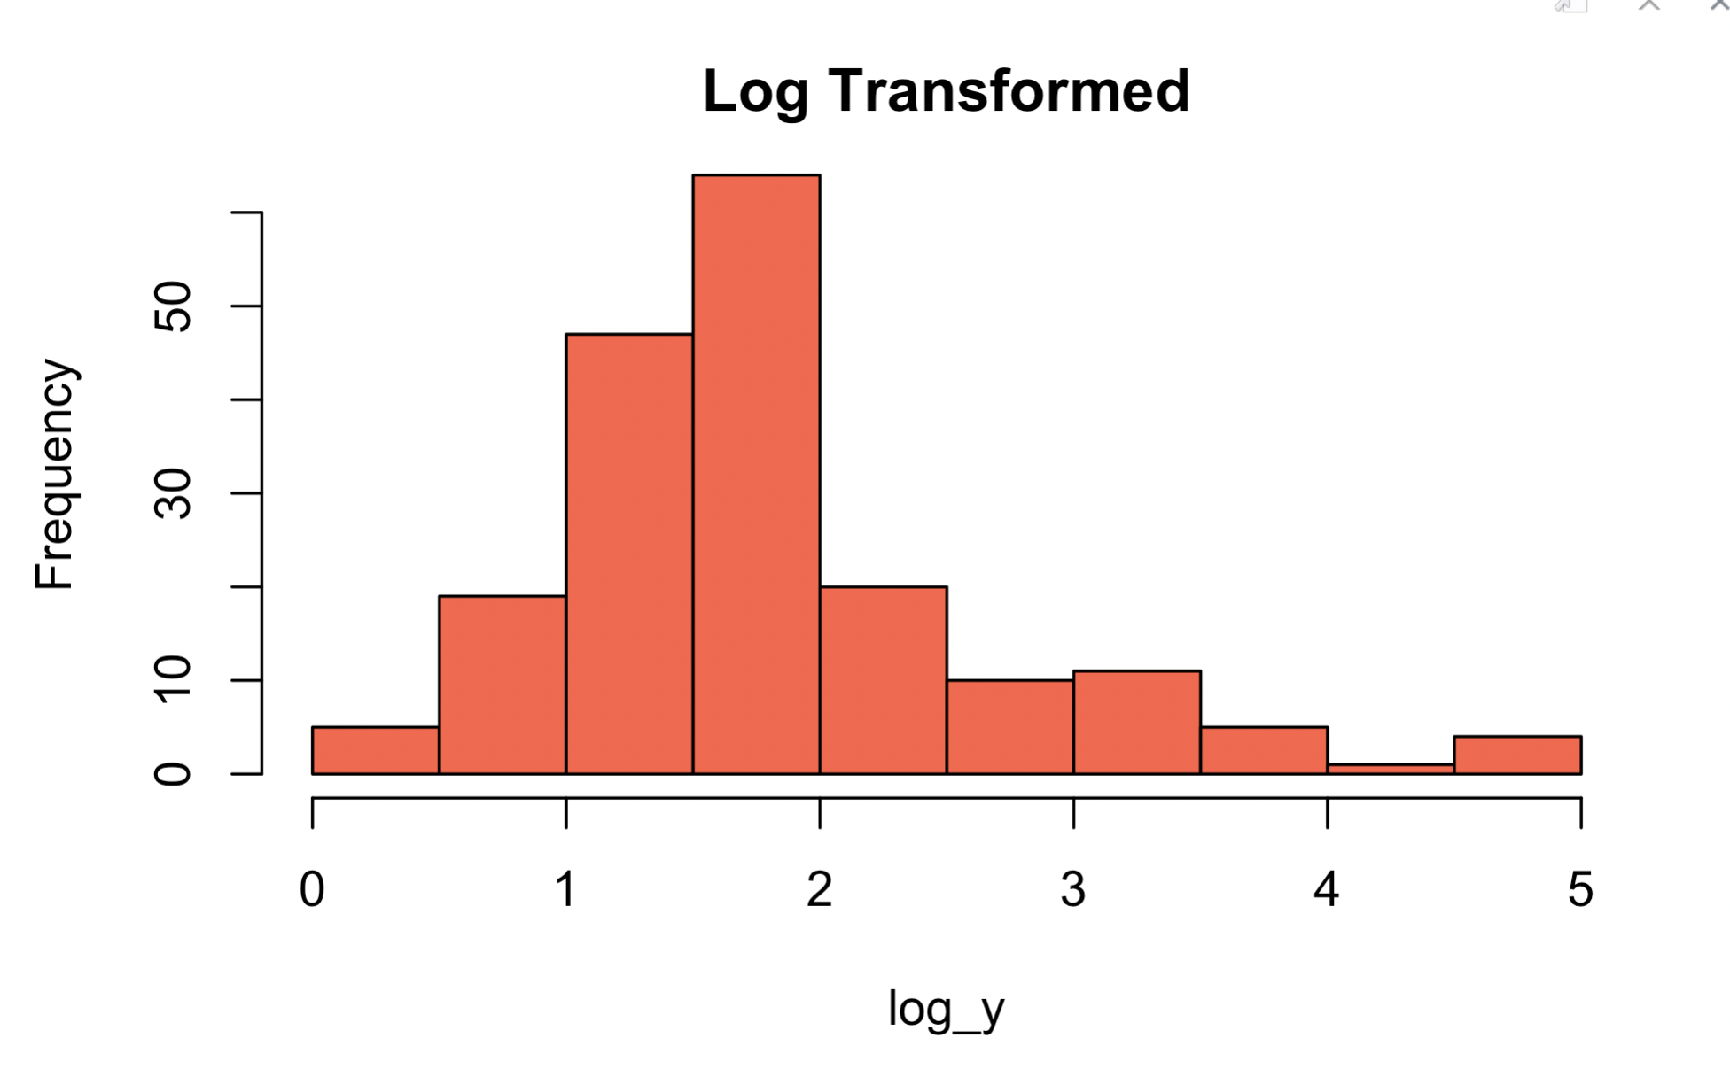
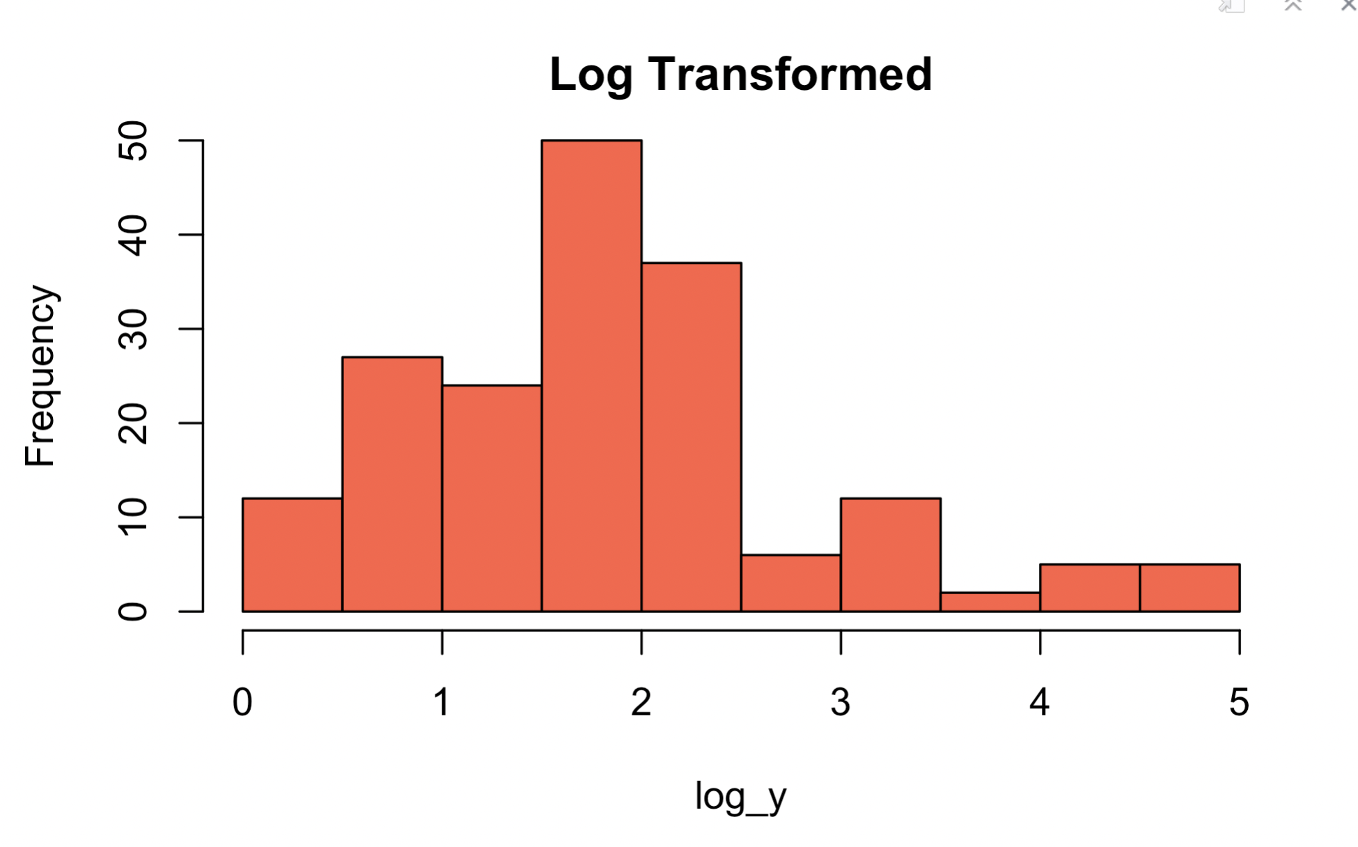
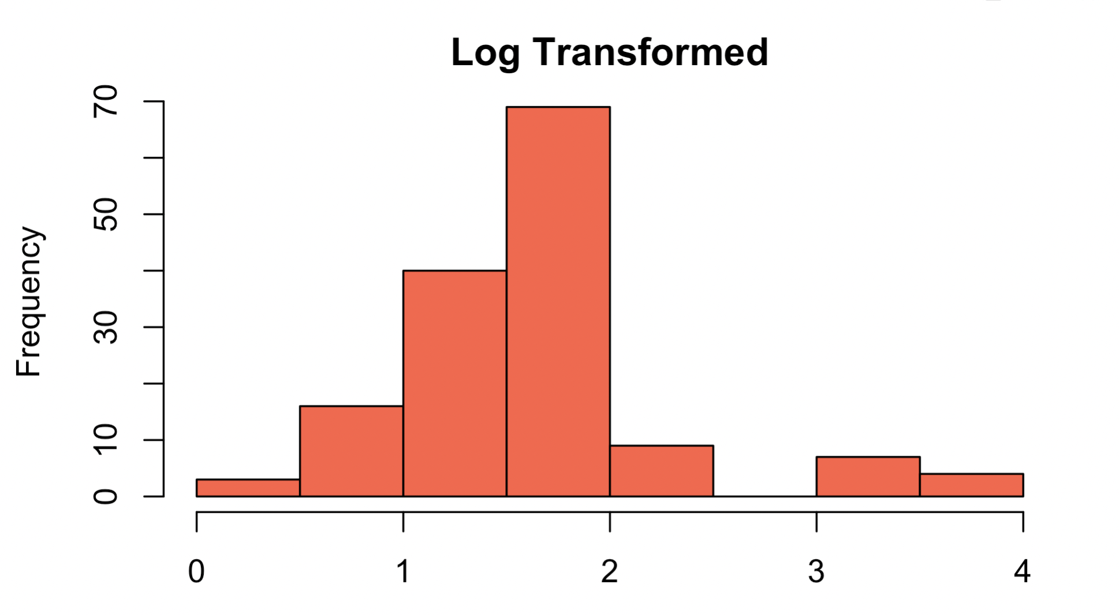
Log Transformed Plot for Unique Functions
Bogota 3 | Bogota 2
Bogota 1 | Bogota 0

Slide 27
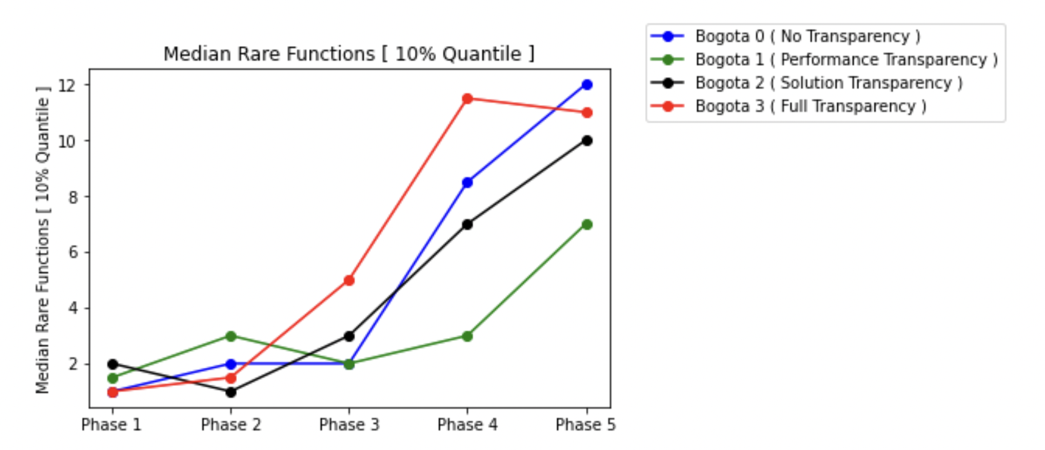
Median Rare Functions [ 10% Quantile ] [ Functions Level ]

Slide 28
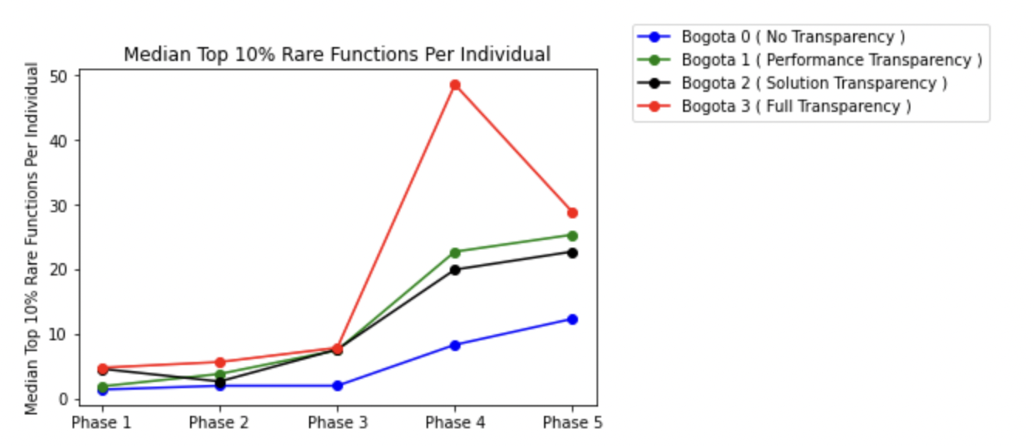
Median Top 10% Rare Functions Per Individual [ Per Phase ]

Slide 29
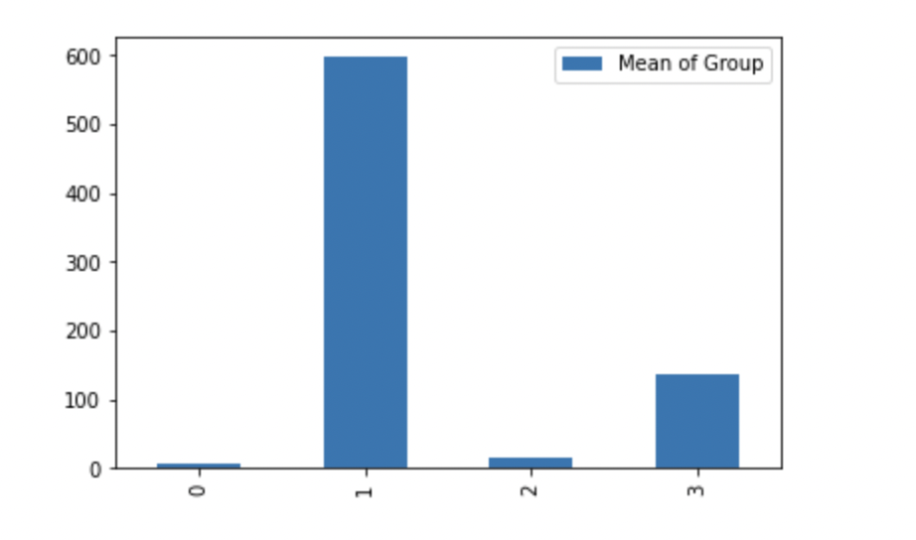
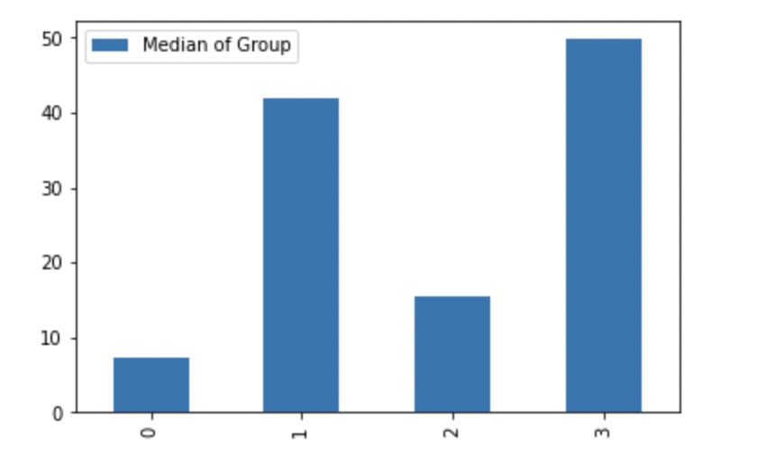
Mean/Median Rare Functions [ 10% Quantile ] [ Individual Level ] [ Overall Case ]
Mean
Median

Slide 30


Mean/Median Rare Functions [ 20% Quantile ] [ Individual Level ] [ Overall Case ]

Slide 31

Distribution of Rare Functions [ 10% ] [ Individual Level ] [ Overall Case ]

Slide 32

Distribution of Rare Functions [ 20% ] [ Individual Level ] [ Overall Case ]

Slide 33

Phase 1 Error Bar for 10% Quantile

Slide 34

Phase 1 Boxplot for 10% Quantile
Extreme outliers
Potential Outliers

Slide 35

Phase 2 Error Bar for 10% Quantile

Slide 36

Phase 2 Boxplot for 10% Quantile
All outliers in this plot are ”extreme” outliers.

Slide 37

Phase 3 Error Bar for 10% Quantile

Slide 38

Phase 3 Boxplot for 10% Quantile
Extreme
Outliers
Potential Outliers

Slide 39

Phase 4 Boxplot for 10% Quantile

Slide 40

Phase 4 Error Bar for 10% Quantile
Extreme outliers
Potential outliers

Slide 41

Phase 5 Boxplot for 10% Quantile

Slide 42

Phase 5 Error Bar for 10% Quantile

Slide 43
Phase 1 Outliers [ Variety Unique Functions ] [ Repetition Removed ] [ Individual ]
Bogota 0 | Bogota 1 | Bogota 2 | Bogota 3
100 < X < 200 Count = 1 | 100 < X < 200 Count = 4 | 100 < X < 200 Count = 1 | 100 < X < 200 Count = 2
 | 200 < X < 300 Count = 1 | 500 < X < 600 Count = 1 | 30,000 < X < 40,000 Count = 1
 | 300 < X < 400 Count = 1 | 30,000 < X < 40,000 Count = 1 | 70,000 < X < 80,000 Count = 1

Slide 44
Phase 2 Outliers [ Variety Unique Functions ] [ Repetition Removed ] [ Individual ]
Bogota 0 | Bogota 1 | Bogota 2 | Bogota 3
100 < X < 200 Count = 1 | 100 < X < 200 Count = 6 | 100 < X < 200 Count = 3 | 100 < X < 200 Count = 2
7000 < X < 8000 Count = 1 | 200 < X < 300 Count = 1 | 400 < X < 500 Count = 1 | 300 < X < 400 Count = 1
 | 300 < X < 400 Count = 1 | 500 < X < 600 Count = 1 | 2,000 < X < 3,000 Count = 1
 | 1000 < X < 2000 Count = 1 | 2,000 < X < 3,000 Count = 2 | 30,000 < X < 40,000 Count = 1
 | 2000 < X < 3000 Count = 3 | 3,000 < X < 4,000 Count = 1 | 70,000 < X < 80,000 Count = 1
 | 20,000 < X < 30,000 Count = 1 | 30,000 < X < 40,000 Count = 1
 | 70,000 < X < 80,000 Count = 1

Slide 45
Phase 3 Outliers [ Variety Unique Functions ] [ Repetition Removed ] [ Individual ]
Bogota 0 | Bogota 1 | Bogota 2 | Bogota 3
100 < X < 200 Count = 1 | 100 < X < 200 Count = 6 | 100 < X < 200 Count = 4 | 100 < X < 200 Count = 4
2000 < X < 3000 Count = 1 | 200 < X < 300 Count = 2 | 400 < X < 500 Count = 1 | 200 < X < 300 Count = 1 300 < X < 400 Count = 1
7000 < X < 8000 Count = 1 | 300 < X < 400 Count = 1 700 < X 800 Count = 1 | 500 < X < 600 Count = 1 | 2,000 < X < 3,000 Count = 2
 | 1000 < X < 2000 Count = 1 | 2,000 < X < 3,000 Count = 3 | 30,000 < X < 40,000 Count = 1
 | 2000 < X < 3000 Count = 3 | 4,000 < X < 5,000 Count = 1 | 70,000 < X < 80,000 Count = 1
 | 20,000 < X < 30,000 Count = 1 | 30,000 < X < 40,000 Count = 1
 | 80,000 < X < 90,000 Count = 1

Slide 46
Phase 4 Outliers [ Variety Unique Functions ] [ Repetition Removed ] [ Individual ]
Bogota 0 | Bogota 1 | Bogota 2 | Bogota 3
100 < X < 200 Count = 1 | 100 < X < 200 Count = 6 | 100 < X < 200 Count = 3 | 100 < X < 200 Count = 2
7000 < X < 8000 Count = 1 | 200 < X < 300 Count = 1 | 400 < X < 500 Count = 1 | 300 < X < 400 Count = 1
 | 300 < X < 400 Count = 1 | 500 < X < 600 Count = 1 | 2,000 < X < 3,000 Count = 1
 | 1000 < X < 2000 Count = 1 | 2,000 < X < 3,000 Count = 2 | 30,000 < X < 40,000 Count = 1
 | 2000 < X < 3000 Count = 3 | 3,000 < X < 4,000 Count = 1 | 70,000 < X < 80,000 Count = 1
 | 20,000 < X < 30,000 Count = 1 | 30,000 < X < 40,000 Count = 1
 | 70,000 < X < 80,000 Count = 1

Slide 47
Phase 5 Outliers [ Variety Unique Functions ] [ Repetition Removed ] [ Individual ]
Bogota 0 | Bogota 1 | Bogota 2 | Bogota 3
100 < X < 200 Count = 1 | 100 < X < 200 Count = 6 | 100 < X < 200 Count = 3 | 100 < X < 200 Count = 2
7000 < X < 8000 Count = 1 | 200 < X < 300 Count = 1 | 400 < X < 500 Count = 1 | 300 < X < 400 Count = 1
 | 300 < X < 400 Count = 1 | 500 < X < 600 Count = 1 | 2,000 < X < 3,000 Count = 1
 | 1000 < X < 2000 Count = 1 | 2,000 < X < 3,000 Count = 2 | 30,000 < X < 40,000 Count = 1
 | 2000 < X < 3000 Count = 3 | 3,000 < X < 4,000 Count = 1 | 70,000 < X < 80,000 Count = 1
 | 20,000 < X < 30,000 Count = 1 | 30,000 < X < 40,000 Count = 1
 | 70,000 < X < 80,000 Count = 1

Slide 48

Count of Least Common Functions ( Top 5% )

Slide 49

Count of Least Common Functions ( Top 10% )

Slide 50

Count of Unique Functions ( Top 15% )

Slide 51

Count of Unique Functions ( Top 20% )

Slide 52

Mean of Exploration for Each Individual

Slide 53

Median of Exploration for Each Individual

Slide 54

Distribution Plot for Exploration Metric [ Full Transparency ]

Slide 55

Distribution Plot for Exploration Metric [ Solution Transparency ]

Slide 56

Distribution Plot for Exploration Metric [ Performance Transparency ]

Slide 57

Distribution Plot for Exploration Metric [ No Transparency ]

Slide 58

Mean of the highest similarity score to the other person

Slide 59

Median of the highest similarity score to the other person

Slide 60

Mean Highest Similarity in Global Functions Context

Slide 61

Median Highest Similarity in Global Functions Context

Slide 62

Minimum Highest Similarity in Global Functions Context

Slide 63

Overlap of No Transparency Case with All Others

Slide 64

Overlap of No Transparency Case with All Others

Slide 65

Overlap of No Transparency Case with All Others

